Slide 1
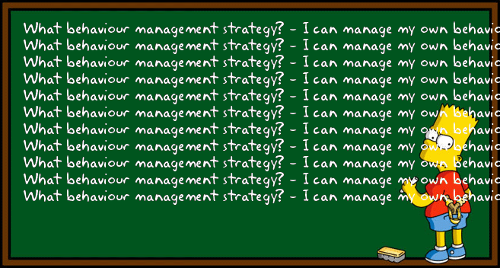
Classroom Management
Libby Jackson-Barrett

Slide 2
Today’s lecture
Why manage behaviour?
Recipe or ‘tool box’ strategies?
Different approaches – some examples of strategies that work
Preventing and responding to misbehaviour through low-key responses

Slide 3
Why manage Behaviour?
1. To create a climate where learning can flourish.
2. To protect basic rights of safety, learning and respect.
To set boundaries in which students can feel safe, successful and achieve.
To teach students about socially appropriate and acceptable choices
Notes:
Although the answer seems obvious at one level, there are a number of goals which effective teachers seek to achieve –
To achieve these goals effectively it is vital that you also consider the style in which you achieve the goals. Effective teachers approach their behaviour management goals with a very positive attitude.

Slide 4
Haim Ginnot spoke of the crucial consequences of teachers’ actions which have the power to affect children’s lives for better or worse. Being able to open, or close, the minds and hearts of children is a responsibility for all teachers to reflect upon.
FACT: Students bring variables into the classroom we have no control over. These variables impact on students behaviour and we (teachers) have to deal with it.

Slide 5
Classroom Management techniques do not come out of a recipe book – they develop over time through experience and upon critical reflection. Experience + Reflection = growth

Slide 6
Successful teachers have a wide range of options open to them. Over their careers they collect skills and strategies and store them away for future use

Slide 7
Different Approaches to Classroom Management
Transactional Analysis – Harris (1960s)
Ginott Model (1960/70s)
Control and Reality Theory – Glasser (1980s)
Jones - Positive Discipline Model (1980s)
Behaviourist Humanistic
Notes:
Continuum theory from one extreme to the other. Spend a moment reflecting on your own experiences of the different approaches taken by the teachers who taught you. Did all teachers use the same strategies?

Slide 8
A positive approach
The positive part of positive behaviour management
means that you are working to create interactions
which allow you to teach children about socially
appropriate behaviour at the same time as
protecting dignity and self esteem.
An emphasis on positive rather then negative statements
Regular and sustained use of praise and rewards
Teaching students the social skills they need to be successful
Re directing students towards success rather than highlighting their mistakes
Notes:
Key features of a positive approach are:

Slide 9
A jigsaw approach to Classroom Management

Slide 10
4 Key Ideas
Teacher Attitude and Actions
The classroom Teacher’s attitude towards student misbehaviour underpins the effectiveness of their management response
Three styles of management

Slide 11
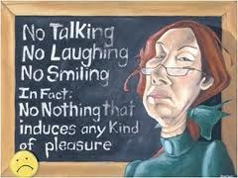
Hostile and aggressive
Students must be controlled
Don’t smile until Christmas as sound advice
Adults deserve respect automatically: children must earn it
If one person gets away with it they’ll all do it
Teaching is a battle that they must win all the time
Notes:
This style believes that : The strategies that are used are

Slide 12
Strategies - tell students what to do - threaten students with punishments - send students to someone else
Outcomes
Poor quality relationships
High quality stress- teacher resilience?
Significantly impairs learning, motivation and risk taking

Slide 13
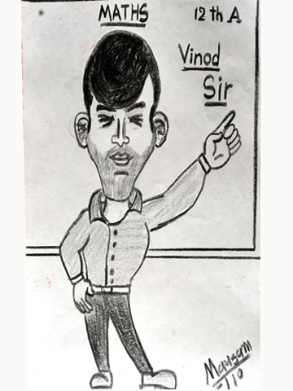
Best Friend
Best Friend
-students need nurturing like buds on a flower
-Being nice and friendly makes students like you
-all you need to do is plan well and you’ll prevent misbehaviour
- negotiate everything
Notes:
Believes that :

Slide 14
Strategies - asking, negotiating, pleading followed by getting frustrated and cross. For example; - how many times do I have to tell you to be quiet? (heavy sigh) - why are you still doing that? (hurt & dismayed) - wait outside, I’m fed up with you (emotional overload)
Outcomes
-Uncertainty leads to insecurity
-leadership in the classroom is ‘up for grabs’
-learning, motivation and risk taking are significantly impaired

Slide 15
Firm but Fair – tough care - a teacher’s job is to set boundaries - a student’s job is to test them - students making mistakes about their behaviour is normal and healthy - students should be helped to experience success and achievement – high expectations
Notes:
Caring also means saying NO and meaning NO at the right time

Slide 16
Strategies - treats behaviour as a choice - holds students accountable for their choice - creates a culture of praise that focuses on what children do well - redirects students towards success - applies sanctions if needed but does NOT hold grudges Outcomes
- students learn boundaries whilst retaining dignity
the teacher is both leader and coach in the classroom
Learning, motivation and risk taking are significantly enhanced

Slide 17
Remember to keep your own emotions in check
Notes:
It is important to maintain emotional balance in busy and fast moving classroom. You are most effective when you are calm and rational. Remember that your emotions significantly influence the classroom climate and that positive emotions build safety and trust.

Slide 18
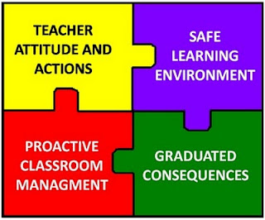

Slide 19
2. Safe Learning Environment
A safe learning environment relies on positive teacher-student and student-peer relationships. Teachers can develop relationships by taking a genuine interest in their student’s lives
RELATIONSHIPS ARE THE KEY

Slide 20
Building positive relationships with students is at the heart of effective behaviour management. A strong relationship connects you to your students however without a connection your ability to influence and lead them is diminished. Allira 6 years

Slide 21
Relationships can be enhanced by
Meeting and greeting children (and their caregivers) by the door
Showing an interest in students as individuals
Listening to their point of view
Giving responsibility to students
Maintaining student’s dignity and self-esteem when things aren’t going accordingly
Treating each and every student with respect
Notes:
Building relationships is also know as winning over

Slide 22
Make an effort to forge positive, respectful relationships with your more challenging students.
Study the purpose and triggers of their behaviours, and learn about their backgrounds.
Use behaviour management strategies which target the cause of their misbehaviour, and remember they too have a right to a safe learning environment.

Slide 23
To build positive relationships with your challenging students, teachers need to demonstrate an active interest in their lives, really listening to their thoughts, opinions, interests and silences.
You may only spend a few minutes talking to a student, but actively listening to them for those few minutes helps to build trust and mutual respect. The cup of coffee can wait. This is important.

Slide 25
3. Graduated consequences
Fairly and consistently apply your system of graduated consequences. Ideally, such consequences should foster student self discipline and bring about behaviour change
Behaviour Management System (BMS) normally a whole school approach –warning, name on board, three strikes = consequence
Notes:
On your school experience research your school’s policy? What do they do?

Slide 26
Bennett and Smilanich offer a concept -The Theory of Bumps
Bump 1 | Low key responses
Bump 2 | Squaring off
Bump 3 | Providing choices
Bump 4 | Implied choices
Bump 5 | Defusing the power struggle
Bump 6 | Informal chat
Bump 7 | Formal Agreement
Bump 8,9 &10 | Suspension and Termination
Notes:
The theory is where the ‘bump’ is an escalation in the student’s behaviour ie move towards power and revenge – bump. The bump is where the student ups the ante and the teacher chooses an appropriate response in order to defuse the situation. Today we are looking at Bump 1 low key responses

Slide 27
Low Key Responses
Low key responses are critical to the successful day to day creation of effective learning environments.
More than one low key response may be used at any time
the KEY is being proactive and prevent the escalation of misbehaviour

Slide 28
Characteristics of low key responses
No or minimal verbal responses
Quick and quiet …. They don’t stop the flow of the lesson
They don’t invite escalation

Slide 29
1. Proximity
The teacher moves towards a misbehaving student/s.
Be aware of how you move and what your body language conveys to the student/s.
Be aware of personal space. The closer you get to the student, the more assertive the stance becomes.
Remember you want to avoid escalation

Slide 30
2. Touch
A quick light touch on the forearm or shoulder by the teacher done in such a way that it is not noticed by others
Be sure to check the school policy as it relates to the use of touch in the classroom and around the school

Slide 31
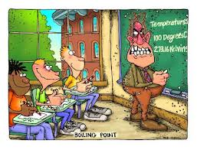
3. The Look
Communicates to the student that their behaviour is inappropriate
Preventative Scan:
Communicates to the students that the teacher
aware of what is happening in the classroom and allows the teacher to address potential disruptions

Slide 32
4. Using the student’s name
Reminds the student that the teacher is aware of what is going on in the classroom
Be aware of your tone of voice
Used to greet or select a student, it is an effective way of winning students over

Slide 33
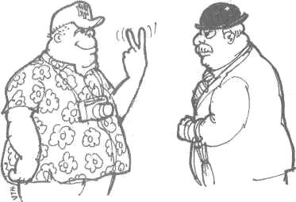
5. The gesture
Usually a hand or facial expression response that communicates the expected behaviour or that the behaviour is inappropriate.
Can be effectively used with other low-key responses
Be aware of cultural differences
Notes:
How would a Brit, a German or an American interpret this gesture?

Slide 34
6. The pause
Communicates to the students that the teacher is aware of what is going on in the classroom
Gives some time to think before responding
Generally used with other low-key responses

Slide 35
7. Ignoring
Communicating that the student’s misbehaviour will not get the desired effect the student wants …. Usually the teacher’s attention
Ignore the student if it does not stop the teacher from continuing or other students from learning
REMEMBER: Always focus on the behaviour NOT the student. This indicates to the student that she/he is accepted in the classroom but the behaviour is not

Slide 36
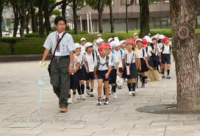
Transitions
Transitions occur anytime
student movement is required
Transitions are the breeding ground for misbehaviour
When transitioning include:
WHEN the students will do it
WHAT the students will do ….
HOW the students will do it ….

Slide 37
Rules
Set guidelines for expected behaviour
in the classroom
The teacher’s ability to act of these rules will determine whether or not the rules make a difference
Consistency is important

Slide 38
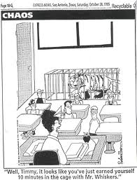
The Theory of Bumps
Some key assumptions ….
Behaviours escalate over time – they don’t happen in isolation
The teacher response must match the student behaviour or the teacher risks losing respect or invites escalation

Slide 39
If one or more pieces of the jigsaw are missing, then the classroom environment becomes dysfunctional.
Notes:
All these things we have talked about here today will be the basis of a proactive classroom management strategy, the last piece of the puzzle. A proactive classroom management approach relates to the facilitation of the teaching and learning process as well as the preventative management of student misbehaviour

Slide 41
Allow yourself to be a beginner. No one starts off being excellent.

